Slide 1
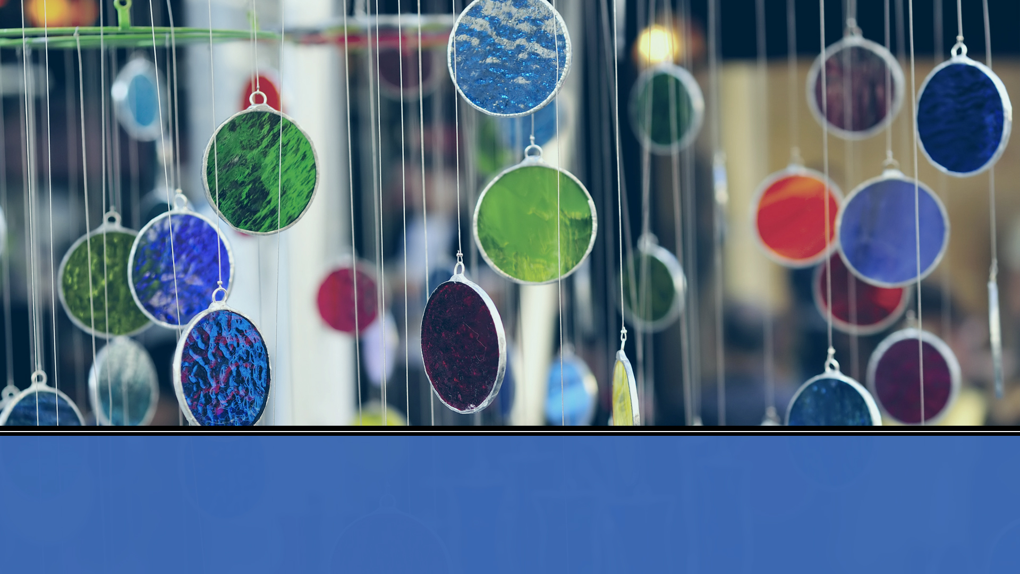
1
Finite Automata and Languages

Slide 2
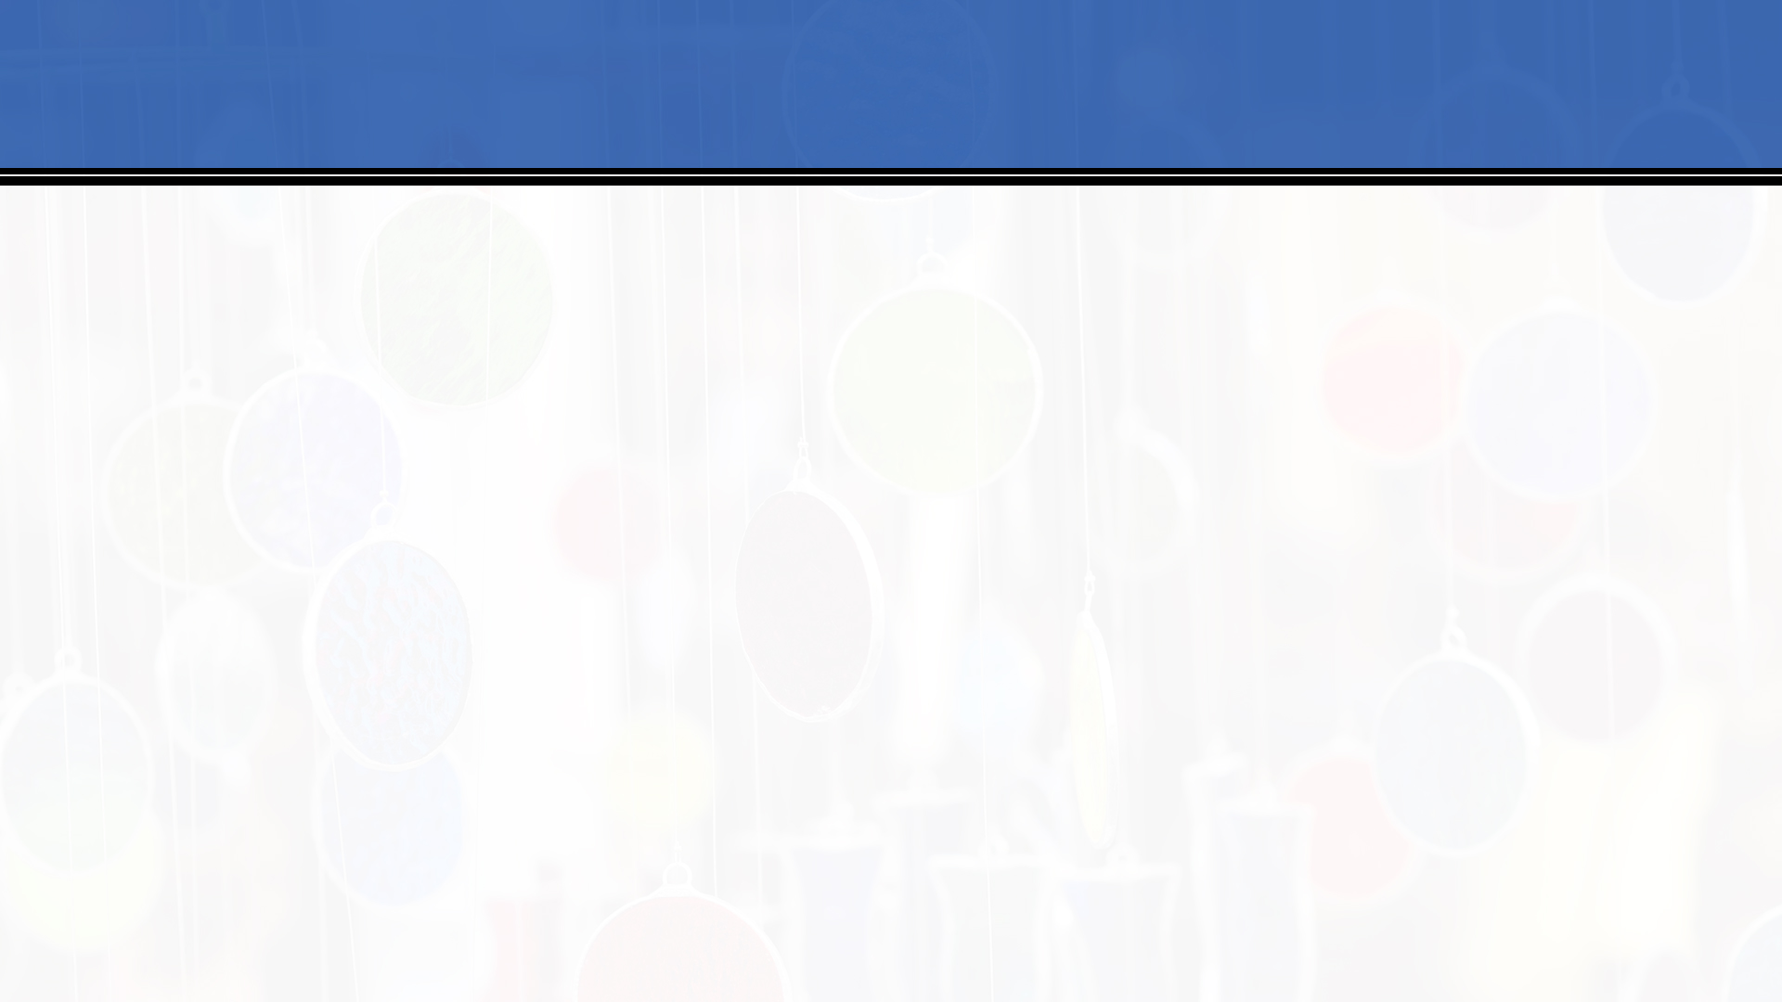
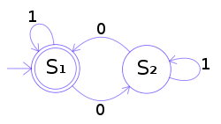
2
Finite Automata
This is a a finite-state machine.
This automaton consists of states (represented in the figure by circles) and transitions (represented by arrows).
As the automaton sees a symbol of input, it makes a transition (or jump) to another state, according to its transition function, which takes the current state and the symbol as its inputs.
The automaton represents a formal language
Stored programs grew out of this concept

Slide 3
2
Push Down Automata
Push down automata also have a stack to store information
This model has input, a stored program, and a stack for storage
This was an early concept of a computer
The stack was the original data structure
Stack

Slide 4
What is a Stored Program?
bool inLang(char * string)
{
bool readB = false;
stack S;
if string[0] != ‘A’;
return false;
i++;
while (string !=NULL)
{
if string[0]==‘A’
if readB
return false;
else
S.push(A);
if string[0]==‘B’
{ readB = true;
if S.isEmpty()
return false;
else
S.pop(); }
string.erase(0, 1); //take off the first character in the list
}
if S.isEmpty() return true;
else return false;
code with states, choices, and results
input
stored variables
Finite automata models the states,
moving between states models response input, stacks model stored variables.
It is a way to formally model your code.
The key is: do you KNOW every state your code can get into? This can tell you if you’ve accounted for every possible state or transition

Slide 5
2
Push Down Automata and Formal Languages
Here is a push down automata that can recognize the language A^{n}B^{n}
read A
push
read B
pop
end of input, stack is empty
-
S _{A}
S_{B}
+
(read B
stack and is empty) or (read A) or (end of input stack not empty)
read A
push
read B
pop
Stack
-

Slide 6
2
Two Stack Push Down Automata
It has been shown that a two stack push down automata can perform any algorithm (!!)
It is equivalent to a Turing Machine – this is the universal computer concept developed by Alan Turing in 1936

Slide 7
2
Two Stack Push Down Automata and Formal Languages
Here is a push down automata that can recognize the language (A^{n}B^{n})^{p}
-
read A
push S1
-
read B
pop S1,
push S2
read A
S1 not empty
read A
pop S2,
push S1
read B
S2 not empty
-
read A
S2 empty
-
S_{A1}
S_{B}
S_{A2}
S1
S2
read B
pop S1,
push S2
end of input
end of input
read B
pop S1,
push S2
read A
pop S2,
push S1
read B
S1 empty
end of input
S1 empty
-
-
read A
push S1
end of input
S1 not empty
-
+
-

Slide 8
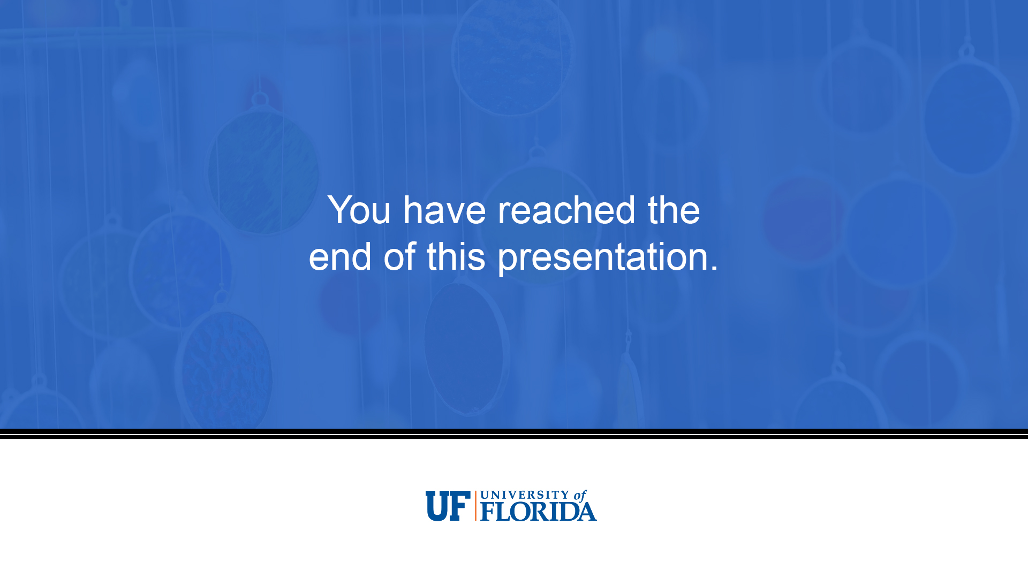
20
Notes:
Production Notes:

